Slide 1

Click anywhere to get started…

Slide 2
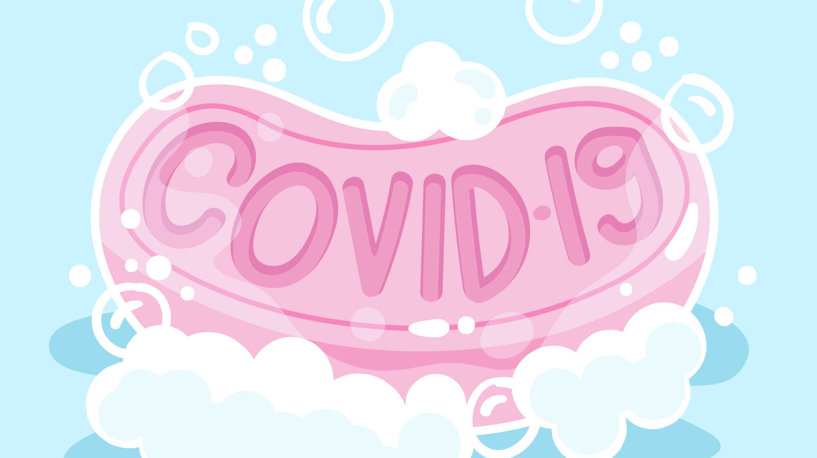


HOW TO WASH YOUR HANDS
Notes:
WHAT YOU NEED TO KNOW ABOUT THE CORONAVIRUS
(COVID-19)

Slide 3
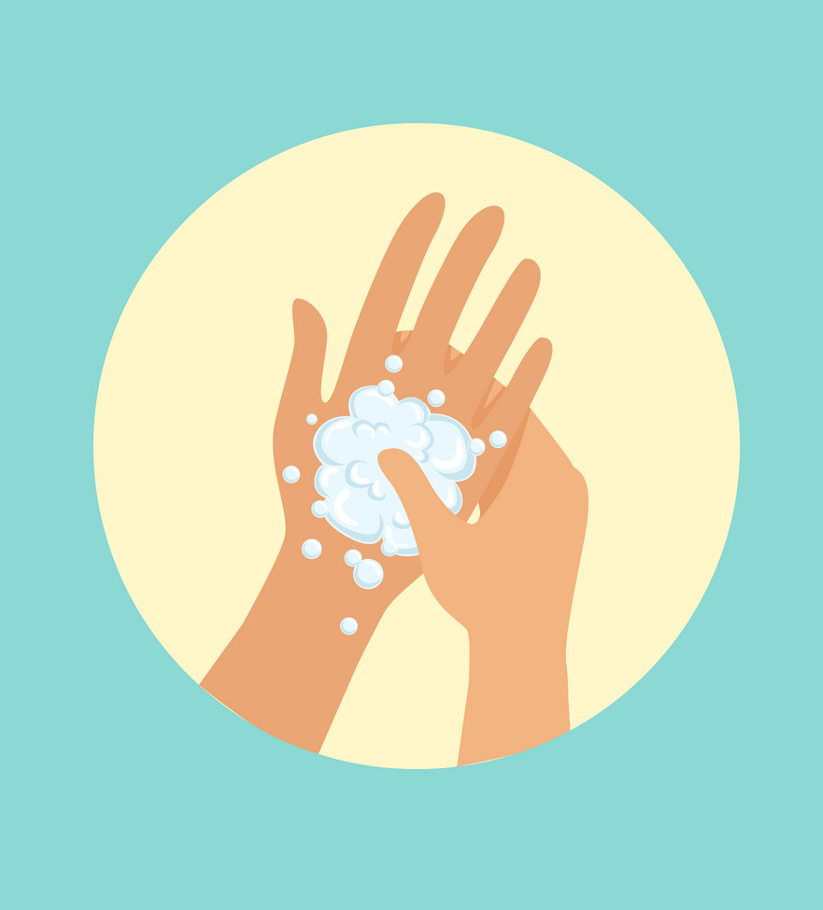
Is Hand Washing Important?
Hand washing is the single most effective way to prevent the spread of infections.
"Good" hand washing techniques include using an adequate amount of soap, rubbing the hands together to create friction, and rinsing under running water.
Wearing gloves is not a substitute for hand washing.
Notes:
Hand washing is the single most effective way to prevent the spread of infections. You can spread certain "germs" (a general term for microbes like viruses and bacteria) casually by touching another person. You can also catch germs when you touch contaminated objects or surfaces and then you touch your face (mouth, eyes, and nose).
"Good" hand washing techniques include using an adequate amount of soap, rubbing the hands together to create friction, and rinsing under running water. Wearing gloves is not a substitute for hand washing.

Slide 4
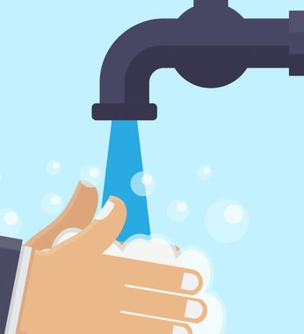
When Should I Wash My Hands?
Even if your hands appear to be clean, they may carry germs. Hands pick up micro-organisms (germs) in a number of ways.
As Needed & Frequently
Notes:
Even if your hands appear to be clean, they may carry germs. Hands pick up micro-organisms (germs) in a number of ways.
When people who are sick sneeze or cough, the germs that are making them sick are expelled into the air in tiny droplets. If these droplets get onto your hands, and then you touch your mouth, eyes or nose without washing away the germs, you carry the infection. You can also get sick if you don't wash your hands before and after preparing food, after handling raw meat, and after using the toilet.
Washing your hands not only prevents you from getting sick, but it also reduces the risk of infecting others. If you don't wash your hands properly before coming into contact with others, you can infect them with the germs on your hands. Other people can also get sick from the germs unwashed hands leave on shared objects like doorknobs, keyboards, and other equipment in the home or workplace.
Different situations where people can pick up "germs" include:
When hands are visibly soiled.
After using the washroom (includes changing diapers).
After blowing your nose or after sneezing in your hands.
Before and after eating, handling food, drinking or smoking.
After touching raw meat, poultry, or fish.
After handling garbage or contact with contaminated surfaces such as garbage bins, cleaning cloths.
Visiting or caring for sick people.
After wiping another person's nose, or handling soiled tissues.
Before preparing or taking medications.
After contact with blood or body fluids such as vomit or saliva.
Before and after treating a cut or wound.
Before inserting and removing contact lenses.
Handling pets, animals or animal waste.
After handling pet food or pet treats.
During a pandemic, it is recommended that you wash your hands frequently. How frequently? It depends, but hourly is a strong recommendation.
Making sure that employees wash their hands properly after using the washroom is very important in reducing disease transmission gastrointestinal infections.
Using soap and lathering up is very important (rinsing hands in water only is not as effective). Use warm running water where possible for comfort, but water temperature is not important to effective cleaning. Hands should be washed for a minimum of 20 seconds all together (rinsing and lathering) – longer if the hands are visibly soiled. To help people (especially children) wash long enough, one option may be to sing a short song such as "Happy Birthday" or "A, B, C" - you might need to sing it twice if you sing fast. The idea of surgeons scrubbing for an operation (as on TV) is very similar.

Slide 5
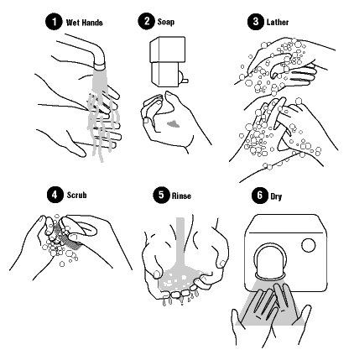

Proper Methods of Hand Washing
Step 1: Wet hands with warm water.
Step 2: Apply soap.
Step 3: Lather & wash hands for at least 20 seconds
Step 4: Scrub under your nails with a brush if available.
Step 5: Rinse
Step 6: Turn off tap using paper towel or air dry if that is available.
Notes:
Although hand washing might seem like a simple task, you should follow these steps to thoroughly rid your hands of germs.
Using Soap
Wash your hands frequently with soap and water for at least 20 seconds. Alcohol-based hand cleansers are useful when soap and water are not available. In most cases antibacterial soap is not necessary for safe, effective hand hygiene.
Remove any hand or arm jewellery you may be wearing and wet your hands with warm water. Add regular soap and rub your hands together, ensuring you have lathered all surfaces for at least 15 seconds. How long is 15 seconds? The length of time it takes to sing Happy Birthday.
Wash the front and back of your hands, as well as between your fingers and under your nails.
Rinse your hands well under warm running water, using a rubbing motion.
Wipe and dry your hands gently with a paper towel, a clean towel or a an air dryer. Drying them vigorously can damage the skin.
Turn off the tap using the paper towel so that you do not re-contaminate your hands. When using a public bathroom, use the same paper towel to open the door when you leave.
If skin dryness is a problem, use a moisturizing lotion.
If you have sensitive skin or are in a position where you must wash your hands constantly (as a healthcare worker must), you might want to use an alcohol-based hand rub instead.
Using Alcohol-based Hand Rubs
An alcohol-based hand rub can be used if soap and water are not available.
If your hands are visibly soiled, it is best to use soap and water. If it's not possible to wash with soap and water, use towelettes to remove the soil, then use an alcohol-based hand rub.
Use hand rubs according to the manufacturer's instructions. Make sure your hands are dry, as wet hands will dilute the product.
Use enough product to cover all the surfaces of your hands and fingers.
Rub your hands together until the product has evaporated. If dry skin is a problem, use a moisturizing lotion.

Slide 6
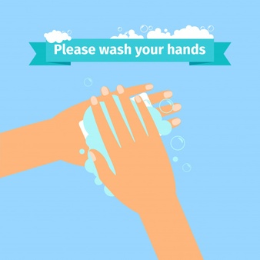
Hand Washing Tips
Cover cuts with bandages and wear gloves for added protection (cuts are very vulnerable to infections).
Artificial nails and chipped nail polish have been associated with an increase in the number of bacteria on the fingernails. Be sure to clean the nails properly.
Keep your hands away from your eyes, nose or mouth.
Assume that contact with any human body fluids is infectious.
Liquid soap in disposable containers is best. If using reusable containers, they should be washed and dried before refilling. If using a bar of soap, be sure to set it on a rack that allows water to drain or use small bars that can be changed frequently.
If dry skin occurs, use a moisturizing lotion.
Notes:
Cover cuts with bandages and wear gloves for added protection (cuts are very vulnerable to infections).
Artificial nails and chipped nail polish have been associated with an increase in the number of bacteria on the fingernails. Be sure to clean the nails properly.
Keep your hands away from your eyes, nose or mouth.
Assume that contact with any human body fluids is infectious.
Liquid soap in disposable containers is best. If using reusable containers, they should be washed and dried before refilling. If using a bar of soap, be sure to set it on a rack that allows water to drain or use small bars that can be changed frequently.
If dry skin occurs, use a moisturizing lotion.

Slide 7
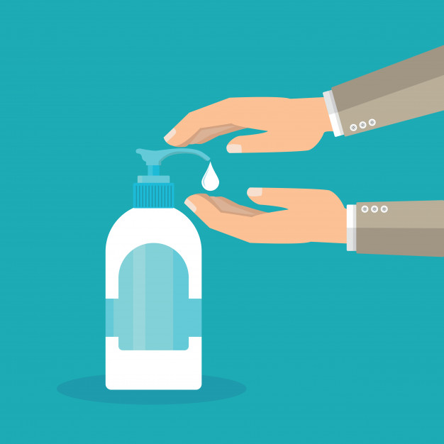
Antibacterial Soap or Hand Sanitizer
If soap and water are not readily available, use a hand sanitizer that contains at least 60% alcohol. Cover all surfaces of your hands and rub them together until they feel dry.
Avoid touching your eyes, nose, and mouth with unwashed hands. Once contaminated, hands can transfer the virus to your eyes, nose or mouth. From there, the virus can enter your body and can make you sick.
Notes:
While it is true that regular soap and water does not actually kill microorganisms (they create a slippery surface that allows the organisms to "slide off"), antibacterial soaps are typically considered to be unnecessary for most purposes. The exception may be in a hospital where special situations are present (e.g., before invasive procedures, when caring for severely immuno-compromised patients, critical care areas, intensive care nurseries, etc.). Antibacterial agents should be chosen carefully based on their active ingredients and characteristics, and when persistent antibacterial or antimicrobial activity on the hands is desired.
When there is no soap or water available, one alternative is to use hand sanitizers or waterless hand scrubs. Some of these products are made of ethyl alcohol mixed with emollients (skin softeners) and other agents. They are often available as a gel, or on wipes or towelettes. Alcohol-based hand sanitizers should contain at least 60% alcohol. Sanitizers do not eliminate all types of germs, and might not remove some chemicals. Hand sanitizers may have odours which may be irritating to some users.
Apply suggested amount to the palm of one hand based on the manufacturer's recommendation.
Rub hands together.
Spread and rub the product over your hands and fingers until your hands are dry.
Use enough product to cover all of your hands and fingers.
Alcohol-based hand sanitizers are the preferred method for healthcare providers when the hands are not visibly soiled. The sanitizers can also be used by paramedics, home care attendants, or other mobile workers where hand washing facilities are not available. However, these agents are not effective when the hands are heavily contaminated with dirt, blood, or other organic materials. Hand washing with soap and water is recommended when hands are visibly soiled.
Once contaminated, hands can transfer the virus to your eyes, nose or mouth. From there, the virus can enter your body and can make you sick.

