Slide 1

Click anywhere to get started…

Slide 2


CORONOVIRUS VS FLU
Notes:
CORONOVIRUS VS FLU

Slide 3

Causes
Both COVID-19 and the flu are viral infections.
Viruses are tiny microbes that survive by invading other living cells. These cells become host cells to the virus, which multiplies inside of them. They can then spread to new cells around the body.
Notes:
COVID-19 and the flu can cause similar symptoms. However, there are several differences between them.
The novel strain of coronavirus (SARS-CoV-2) causes coronavirus disease 19 (COVID-19).
Both COVID-19 and the flu are respiratory illnesses that spread from person to person. This training will discuss the differences between COVID-19 and the flu.
Both COVID-19 and the flu are viral infections.
Viruses are tiny microbes that survive by invading other living cells. These cells become host cells to the virus, which multiplies inside of them. They can then spread to new cells around the body.
Coronaviruses are a family of viruses that cause respiratory infections. The SARS-CoV-2 causes the infection that leads to COVID-19.
There are two types of viruses that cause the flu — influenza A and B. There are also several subtypes of influenza A. Any of these viruses can cause the flu.

Slide 4
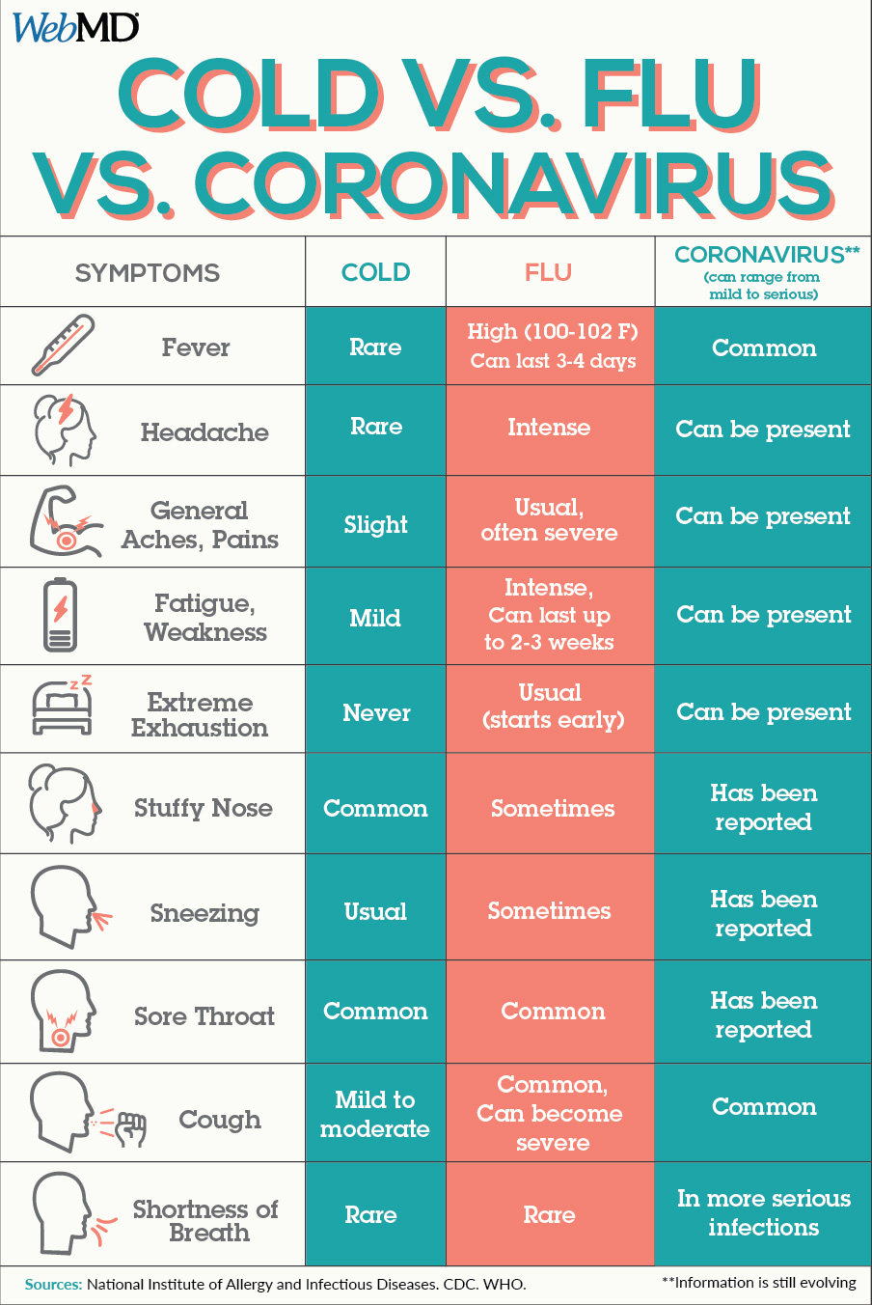
What Are The Symptoms?
COVID-19 and the flu can cause similar symptoms. However, there are several differences between them.
Notes:
The symptoms of the flu and COVID-19 have some differences.
People who have the flu will typically experience symptoms within 1–4 days. The symptoms for COVID-19 can develop between 1–14 days. However, according to 2020 research, the median incubation period for COVID-19 is 5.1 days.
As a point of comparison, the incubation period for a cold is 1–3 days.
The symptoms of COVID-19 are similar in both children and adults. However, according to the Centers for Disease Control and Prevention (CDC), children typically present with fever and mild, cold-like symptoms, such as a runny nose and a cough.
The following table outlines the symptoms of COVID-19, the flu, and a cold.T

Slide 5

Severity
According to the WHO, around 15% of COVID-19 cases are severe, and 5% are critical. Those in a critical state require a ventilator to breathe. The chance of severe and critical infection is higher with COVID-19 than the flu.
COVID-19 is also more deadly. According to the WHO, the mortality rate for COVID-19 appears to be higher than that of the flu.
Notes:
The symptoms of COVID-19 and flu can range from mild to severe. Both can also cause pneumonia.
It is important to note that the World Health Organization (WHO) have classified mild symptoms of COVID-19 to mean that a person will not require hospitalization. The WHO classify mild cases to consist of symptoms including:
fever
cough
fatigue
loss of appetite
nasal congestion
sore throat
headache
According to the WHO, around 15% of COVID-19 cases are severe, and 5% are critical. Those in a critical state require a ventilator to breathe. The chance of severe and critical infection is higher with COVID-19 than the flu.
COVID-19 is also more deadly. According to the WHO, the mortality rate for COVID-19 appears to be higher than that of the flu.
Compared with the flu, research on COVID-19 is still in its early stages. These estimates may change over time.

Slide 6

Transmission
Both SARS-CoV-2 and the flu virus can spread through person to person contact.
According to the WHO, the speed of transmission differs between the two viruses. The symptoms of flu appear sooner, and it can spread faster than the SARS-CoV-2 virus.
Notes:
Both SARS-CoV-2 and the flu virus can spread through person to person contact.
Tiny droplets containing the viruses can pass from someone with the infection to someone else, typically through the nose and mouth through coughing and sneezing.
The virus can also live on surfaces. The WHO is not sure exactly how long the virus can survive, but it could be days.
According to the CDC, people can transmit the flu virus to people who are 6 feet (ft) away. According to the WHO, people should stay at least 6 ft away from anyone coughing or sneezing to help prevent the transmission of the SARS-CoV-2 infection.
According to the WHO, the speed of transmission differs between the two viruses. The symptoms of flu appear sooner, and it can spread faster than the SARS-CoV-2 virus.
The organization also indicate that people with flu can pass the virus on before they show any symptoms. A person can also pass on the SARS-CoV-2 infection even if they have no symptoms.
There are also differences in transmission between children and adults.
According to the WHO, the transmission of the flu from children to adults is common. However, based on early data it appears that it is more common for adults to pass the SARS-CoV-2 infection onto children. Children are less likely to develop symptoms.

Slide 7
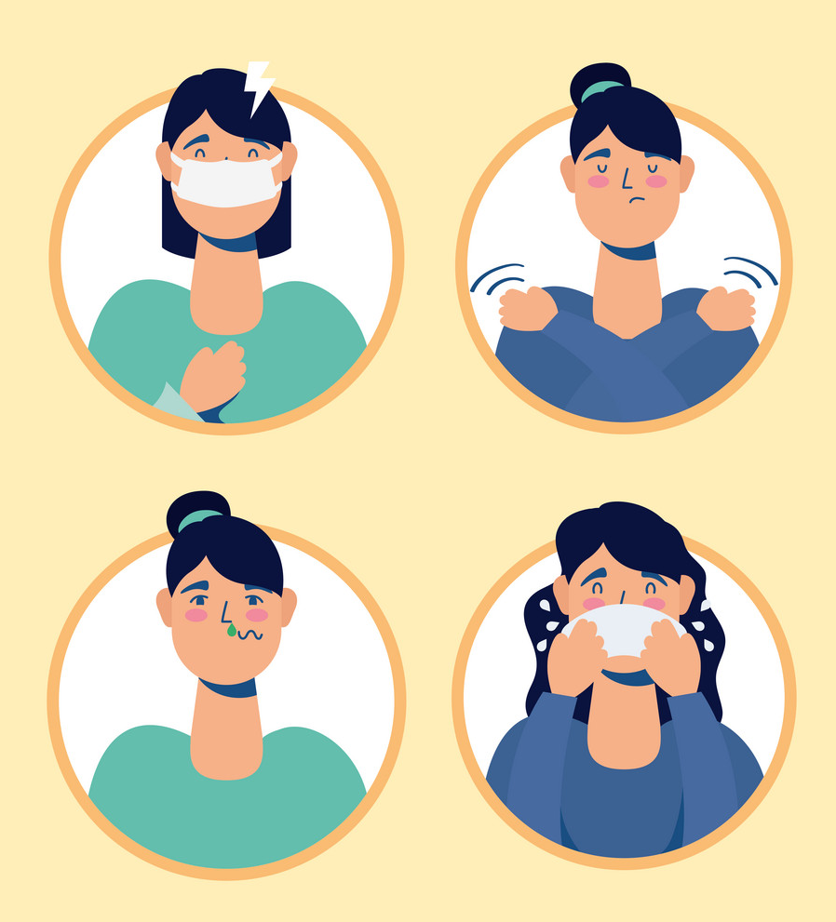
Treatment
As flu has been around much longer than COVID-19, there are more treatment options.
Most people with the flu do not require medical treatment.
There are currently no antiviral drugs approved to treat COVID-19, although scientists are currently researching drugs in trials.
Notes:
As flu has been around much longer than COVID-19, there are more treatment options.
Most people with the flu do not require medical treatment. But a doctor might prescribe antiviral drugs in some cases, which can reduce the symptoms by 1–2 days.
These antiviral drugs help the body fight the virus. They treat symptoms and reduce how long the illness lasts.
There are currently no antiviral drugs approved to treat COVID-19, although scientists are currently researching drugs in trials. When scientists have had more time to study the disease, the availability of antivirals to treat COVID-19 will likely increase.
Although there is currently no approved treatment or vaccination for COVID-19, there are ways to help treat the symptoms and any complications that can occur.
For mild cases, a person should remain home and undertake social distancing. Healthcare professionals may prescribe antipyretics to reduce the fever.
For more severe cases, a person may require supplemental oxygen or mechanical ventilation on a breathing machine to treat the respiratory problems that may occur.

Slide 8

Prevention
The best way to prevent spreading the SARS-CoV-2 virus includes:
washing hands regularly
avoiding touching the face
keeping at least 6 ft away from anyone sneezing and coughing
covering the mouth when sneezing or coughing
staying at home if feeling unwell
working from home if possible
avoiding crowds and gatherings of any size
Notes:
The most effective way of preventing the flu is through vaccination.
Many strains of influenza can cause infection. The most common strains vary depending on the season.
Doctors will try to predict what strains will be most common each season to select the right vaccine components.
There is currently no vaccine available for the SARS-CoV-2 infection. The virus is new, and developing safe vaccines takes time.
The best way to prevent spreading the SARS-CoV-2 virus includes:
washing hands regularly
avoiding touching the face
keeping at least 6 ft away from anyone sneezing and coughing
covering the mouth when sneezing or coughing
staying at home if feeling unwell
working from home if possible
avoiding crowds and gatherings of any size
Source – Medical News Today

